Slide 1
<< A Meta Slide >> Original outline:
https://docs.google.com/presentation/d/1ErKEfiOYswZf6vGHXcwRLTZpGoj1LjWa/edit#slide=id.p1
This template provides an approximate outline for your project presentation
Do not use my generic slide headers; use headers appropriate for your particular project.
The overall goal of the presentation:
Clearly convey the nature and significance of the problem/opportunity your project addresses
Clearly identify the scope of your project, your approach, current status, and future plans
Assume the audience is technically savvy but not expert in your project domain or the technologies you work with
Briefly explain key concepts if you can’t be sure the audience is familiar with them
Use diagrams and illustrations when and where helpful
Use the fewest words possible (on the slide) to clearly communicate the meaning
Let your talk do the talking
Time allowed: 10 min (8 for presentation + 2 Q&A)

Slide 2

Scrum Tools Senior Design Project 3/14/2024
Team Members:
Andrew Hu
Michael Alaniz
Edison Chen
Arthur Foy
Tanya Gyanmote
Sponsors and Stakeholders:
Golam Md Muktadir (UCSC)
Andrew Rivero (UCSC)

Slide 3
Project Management (with Scrum)
Anyone trying to use Scrum as a management system
Software engineers working in teams
Students learning how to enact Scrum
Companies looking for a project management software
Andrew
Notes:
Mention that the last bullet point is a stretch goal for after we are done

Slide 4
Support for Scrum Users
Our project will support teams who are using Scrum
Product Owners
Scrum Masters
Team Members
Andrew

Slide 5
What is the problem we are trying to solve?
Scrum is a widely used process that is hard to follow
Team members have a lot of meetings to attend
Scrum masters have a lot of documents to keep synchronized
Companies practicing Scrum often skip key steps in the process
leads to “flaccid Scrum”
Andrew
Notes:
expand more on this, signing, scrum specific

Slide 6
Project Goals
Streamline the Scrum Process
Synchronize elements across documents
Organizing stories and sprints
Enforces Scrum practices
Planning Poker
Signing Releases and Sprints
Goals for Release 1
Release plan page
Overcome infrastructure and spikes
Goals for Release 2
Release plan page
Signing release plans
Planning poker
Sprints
Edison

Slide 7
Project Constraints
Web App
ORM
Relational Database
Tanya
3

Slide 8
Challenges
Building off of the problematic existing project that the previous team had worked on.
Considered whether starting from scratch would be easier.
Translating the sponsor’s idea into a satisfactory design and database schema.
Challenges in learning the new database technology which the sponsor recommended we use.
Keeping clean and well-factored code
Arthur

Slide 9
Approach
Frontend
Create designs as a team
Get sponsor approval before implementation
Backend
Watch tutorials for the new technologies
Diagram the data models and relations between users, sprints, tasks, etc.
Unit testing as we go
Create a backend API where users can create projects, release plans, and sprints
Arthur
4

Slide 10
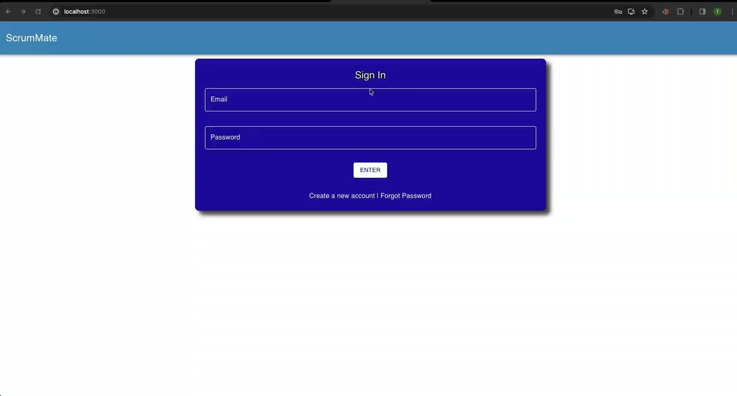
System Illustration
Tanya

Slide 11
Architecture Diagram
Frontend
Backend
API Calls
Andrew

Slide 12
Architecture Diagram: Frontend
Scrum Tools
Create
Copy
Get
Revisions
Problem Statement
High level goals
Create
Get
Reorder
etc…
Sprints
Product Backlog
Andrew

Slide 13
Architecture Diagram
Frontend
Backend
API Calls
Andrew

Slide 14
Architecture Diagram: Backend
Singleton Database
API Calls
ORM
Routers
Middleware
Controllers
Repositories
Wrappers
Andrew

Slide 15
Architecture Diagram: Backend
API Calls
Singleton Database
ORM
Routers
Middleware
Controllers
Repositories
Wrappers
User
Router
Auth,
Error Handler
User
Ctrler
User
Repo
User
Wrap
ORM
Singleton Database
Sprint
Router
Sprint
Ctrler
Sprint
Repo
Sprint
Wrap
Andrew

Slide 16
Architecture Diagram: Backend
API Calls
Singleton Database
ORM
Routers
Middleware
Controllers
Repositories
Wrappers
User
Router
Auth,
Error Handler
User
Ctrler
User
Repo
User
Wrap
ORM
Singleton Database
Sprint
Router
Sprint
Ctrler
Sprint
Repo
Sprint
Wrap
orm.find({id:1})
GET /api/user/1
db.userRepository.findUser(1)
userWrap.lookupUserId(1)
Andrew

Slide 17
Technologies Used:
React.js - Front End
Used for creating front end pages.
User for designing user experience.
MaterialUI - Front End Styling
CSS/React library for styling.
Express.js - Backend REST API
Used for creating API that communicates to the database.
TypeORM - PostgreSQL database management
Database library that handles calls to PostgreSQL library.
Michael Alaniz

Slide 18




Technologies
Singleton Database
TypeORM
Routers
Middleware
Controllers
Repositories
Wrappers
Michael

Slide 19
Results
Goals at the beginning:
Redesign Pages
New Release Plan Page
Signing Release Plans
Goals achieved:
Redesign Pages
New Release Plan Page
Edison

Slide 20
Major Achievements
Revamped the Backend
Switched to new database
Organized and refactored to be easily extendable
Re-designed the pages
Revamped the Release Plan page
Allow Dragging of Sprints
Edison
Notes:
Clean and documented code
API documentation

Slide 21
Release 2: Goals
Objectives:
Complete functionality of the different pages.
Full backend integration.
Vision:
All of the integration do with the project.
Have a well defined user experience.
General Outline:
Work on the different pages similar to how we achieved the release plan page.
How to tell if the project is was a success?:
Completed front end (Login, Release Plan, etc.) with full working features.
Finished all of the user stories that are not stretch goals.
Michael Alaniz

